Slide 1
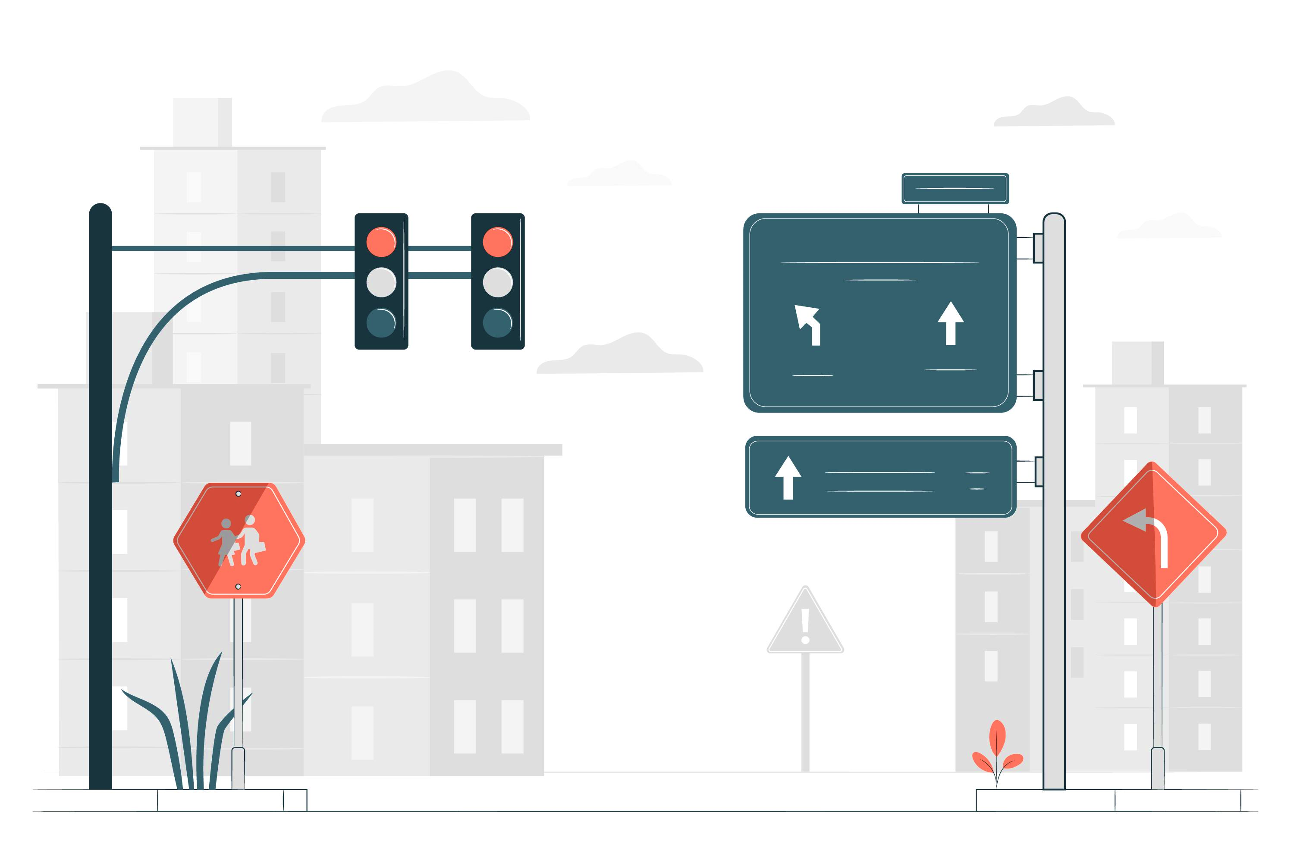
Evaluating automated traffic violation detection system for road safety improvement
24 – 25J - 165

Slide 2
Our Team
 | Name | Student ID
1 | Seneviratne K.A.C.M | IT21212222
2 | Wennawaththa.W.W.V.N | IT21186288
3 | Wathsala W.H.D | IT21334306
4 | Mahindapala G.H.N.K | IT21327926

Slide 3
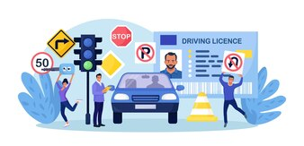
Introduction
Addressing three critical violations: running red lights, invalid U-turns and crossing stop lines.
Aiming to improve road safety by detecting and managing these violations effectively.
Implementing an integrated system
for real-time monitoring, violation
detection and automated
reporting to enhance
enforcement.

Slide 4

Research Problems
Inconsistent Violation Detection
Limited Real-time Updates
Ineffective Violation Reporting
Data Management Challenges

Slide 5
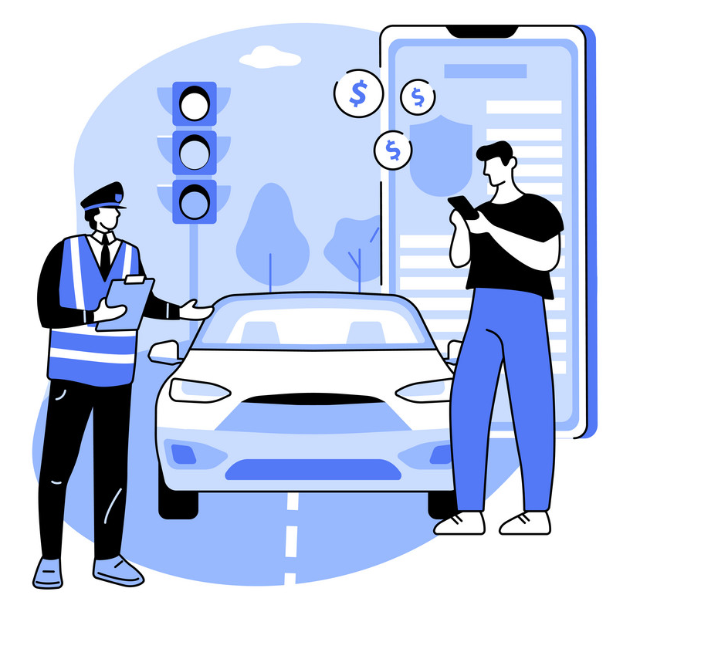
Main Objective Develop an automated traffic violation detection system with backup cameras to enhance safety, track vehicles, and ensure effective law enforcement
Sub Objectives
Detecting violation from Primary & Secondary camera system.
Identifying the vehicle & vehicle type
Analyse the traffic and display on LED Screen
Maintaining profiles and report the details to police station.

Slide 6
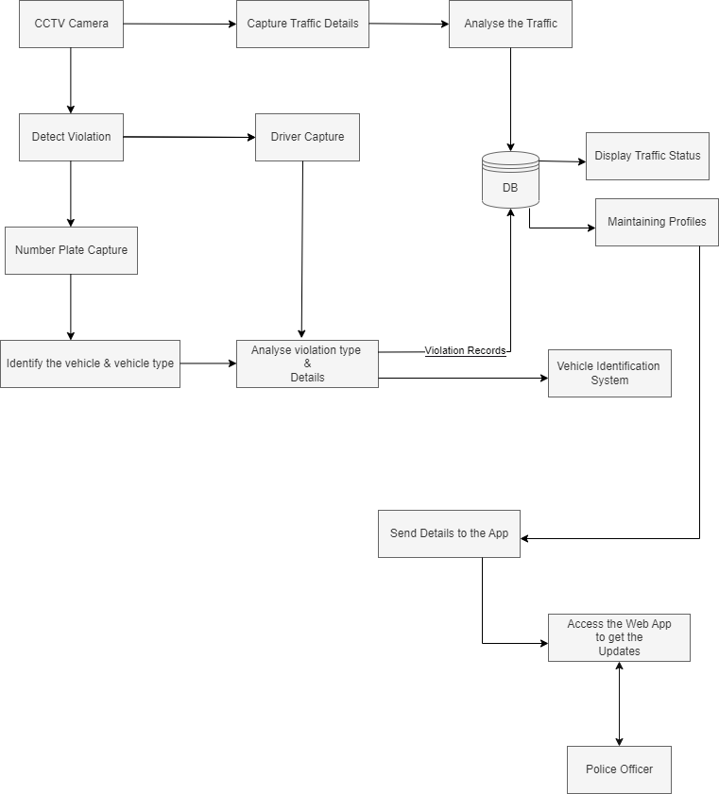
System Diagram

Slide 7

IT21212222 | Seneviratne.K.A.C.M
BSc (Hons) Degree in Information BSc (Hons) Degree in Information Technology
Specialized in Information Technology
IT21212222 | <<Seneviratne.K.A.C.M>> | <<24-25J-165>>

Slide 8
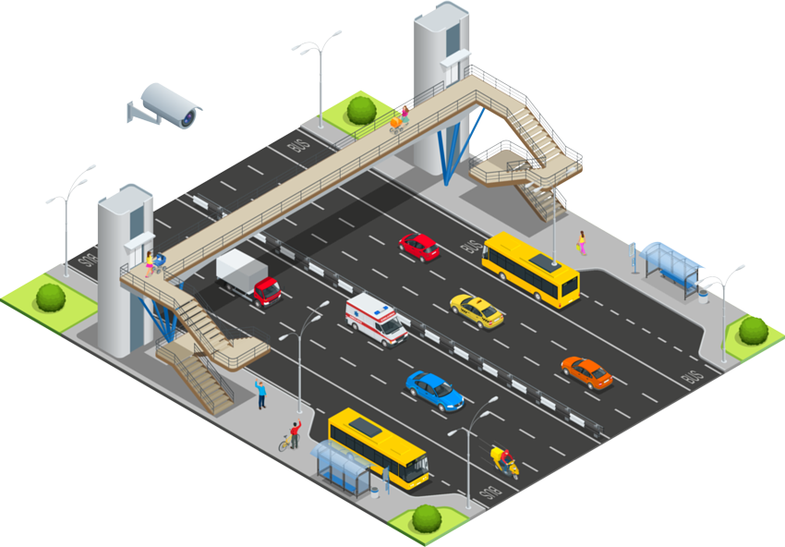
Background
Importance of Traffic Safety
Existing Systems
Technological Advances
IT21212222 | <<Seneviratne.K.A.C.M>> | <<24-25J-165>>

Slide 9

Research Problem
Accuracy Issues
Real-time Processing Issues
Scale Effectively
IT21212222 | <<Seneviratne.K.A.C.M>> | <<24-25J-165>>

Slide 10


Research Gap
Aspect | System A | System B | System C | Our Project
Integration of Advanced Technologies
Low Light and Night-Time Performance
Real-Time Processing Efficiency
IT21212222 | <<Seneviratne.K.A.C.M>> | <<24-25J-165>>

Slide 11
Objective
To develop an advanced traffic monitoring system that accurately identifies red-light running and invalid stop line crossings using a main camera system enhanced with computer vision and machine learning technologies.
Sub-Objectives
Detection Model Development
Real-time Processing
IT21212222 | <<Seneviratne.K.A.C.M>> | <<24-25J-165>>

Slide 12
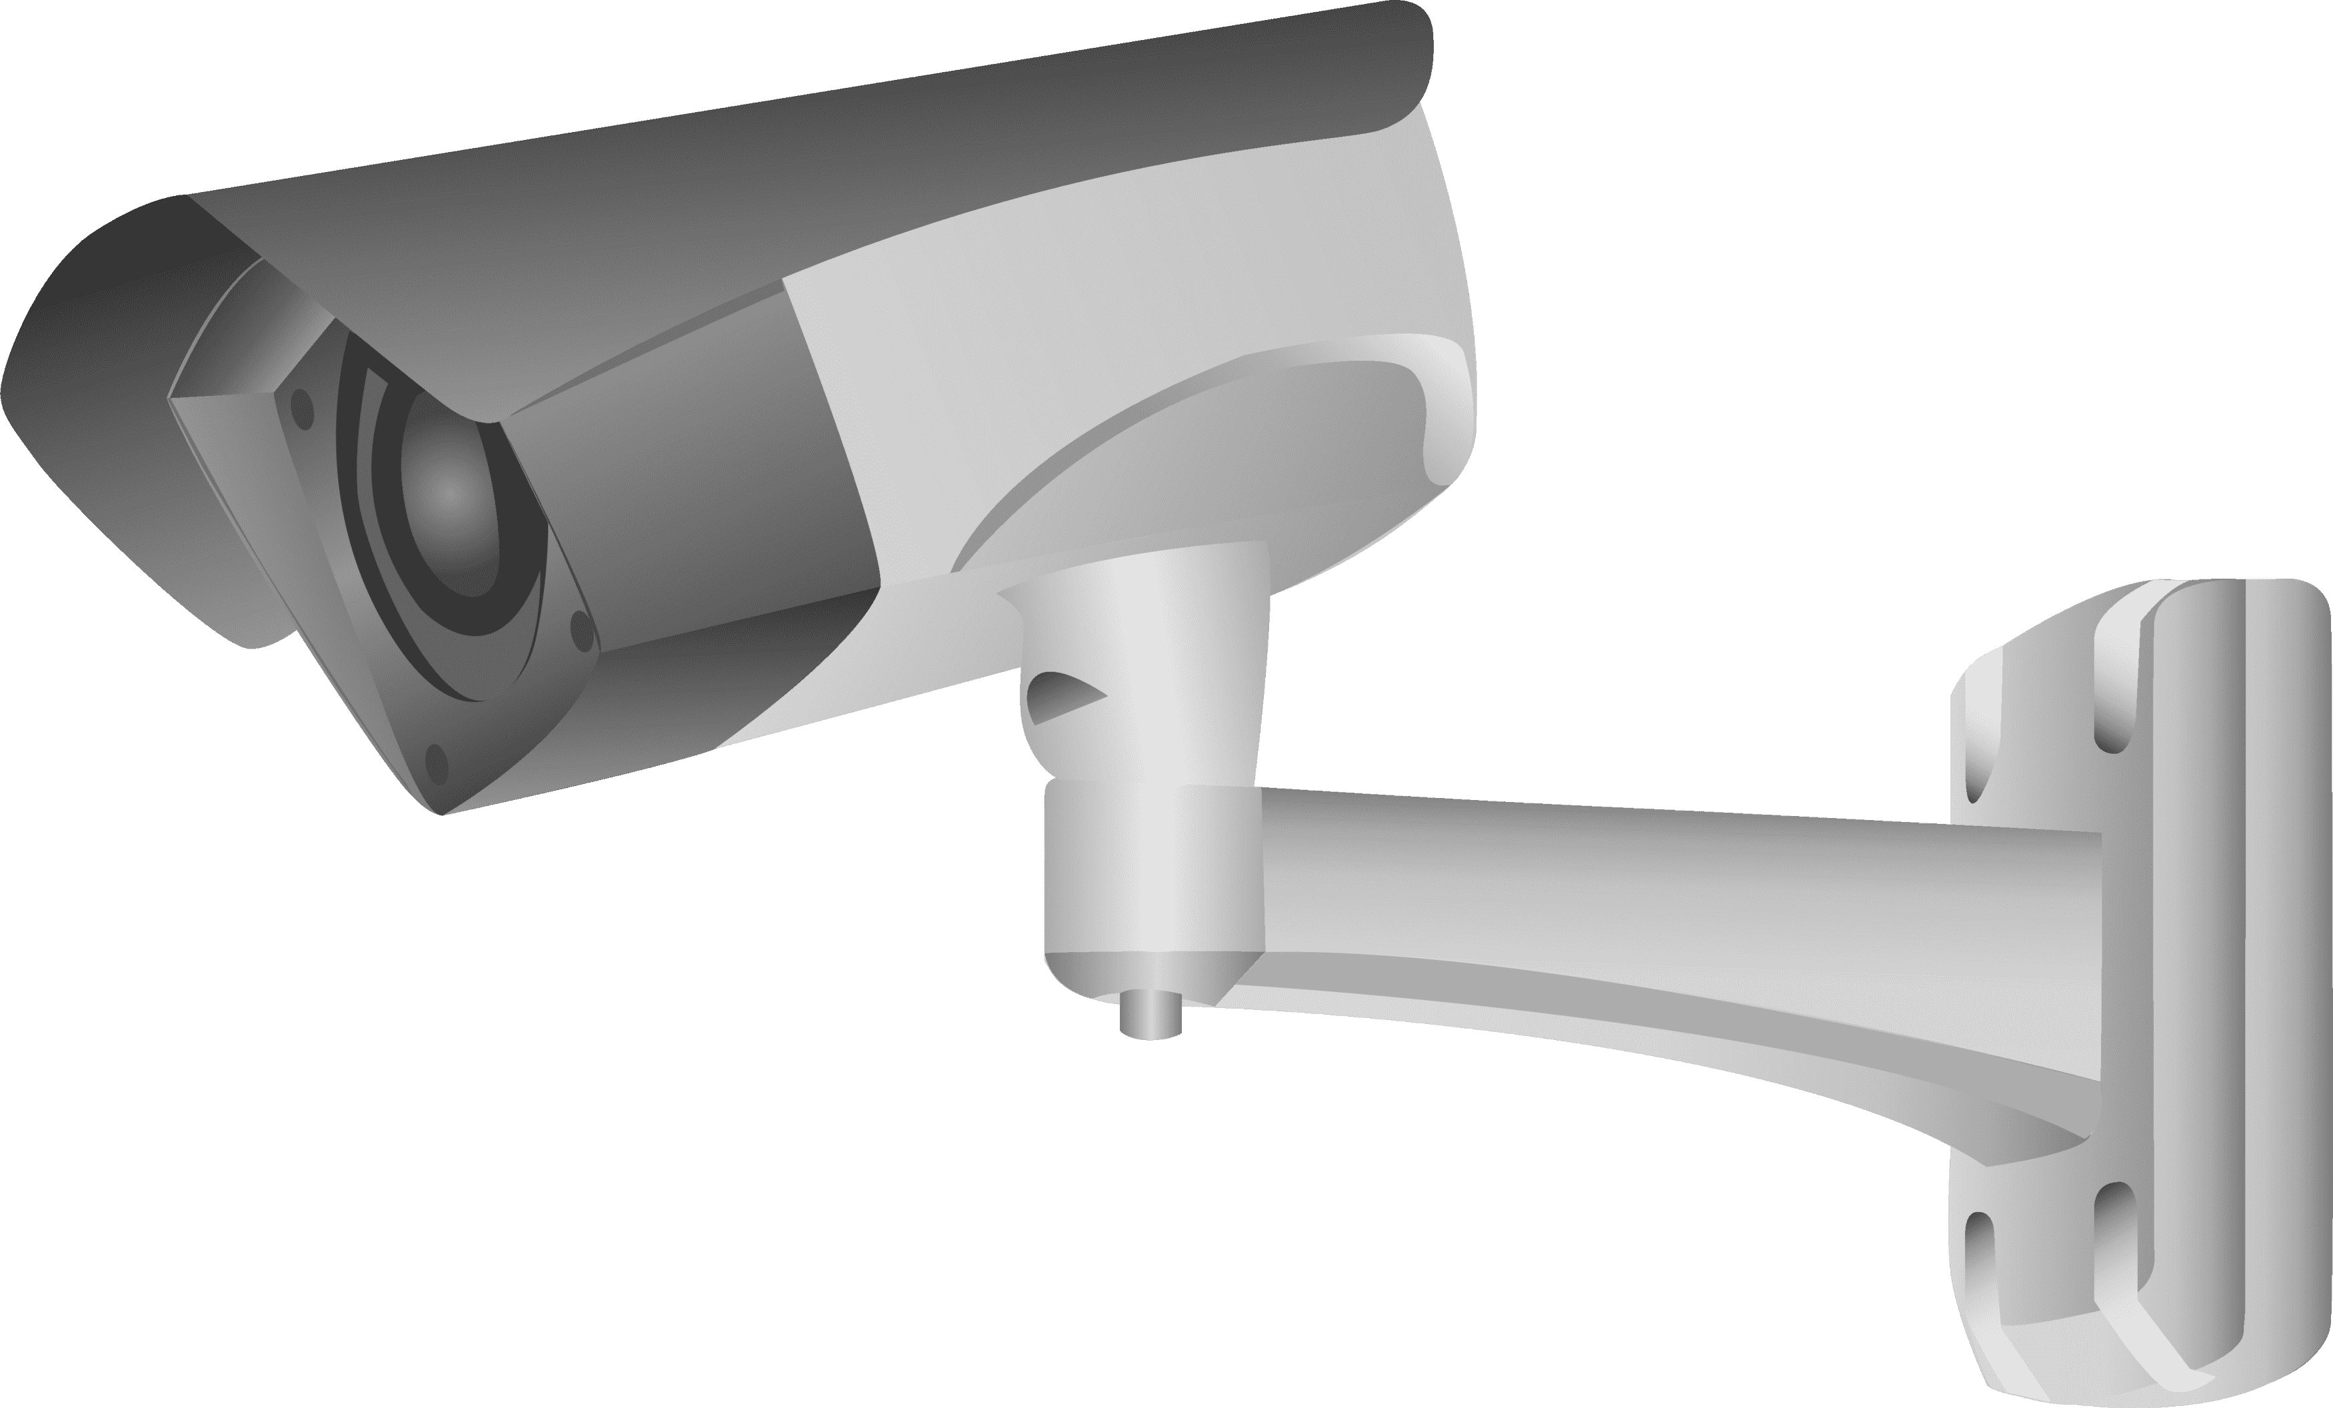



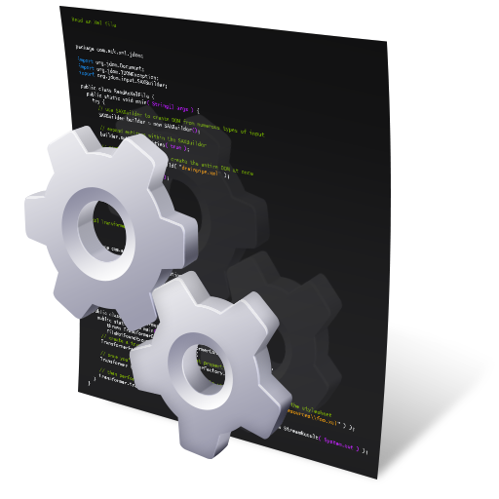
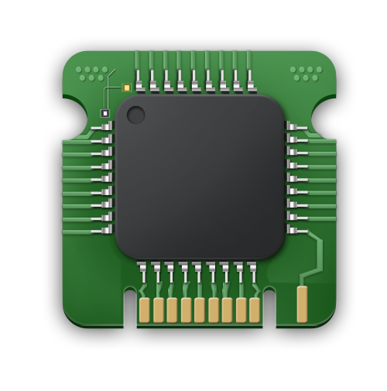
Methodology
Database
Cameras
Violation Records
Analyze Frames for Violations
Send Violation Footages
Capture Traffic
Send Data
Central Server
Vehicle Identification System
Detection Models
Edge Processing Unit
IT21212222 | <<Seneviratne.K.A.C.M>> | <<24-25J-165>>

Slide 13
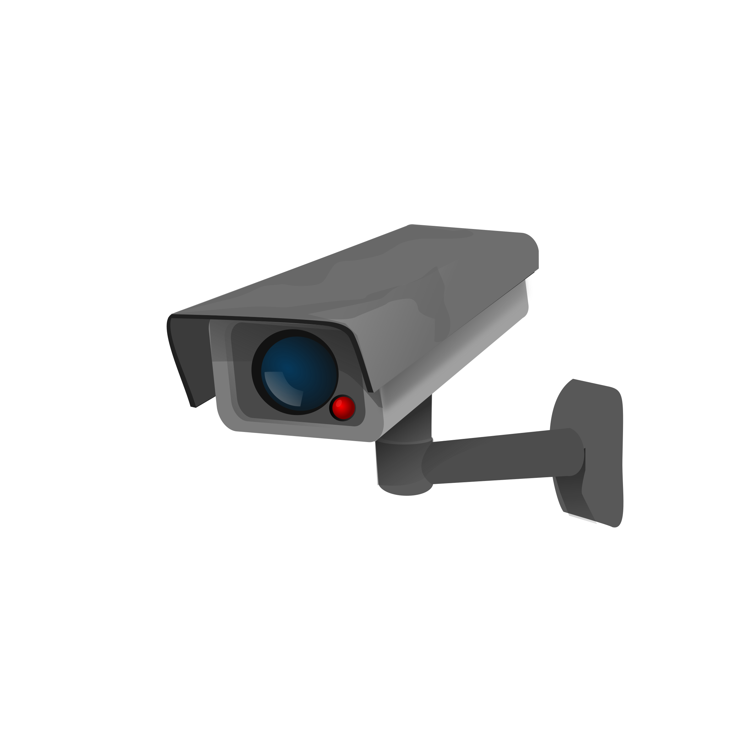


Technologies
Computer Vision: OpenCV
Hardware: High-resolution cameras
Software: Python
IT21212222 | <<Seneviratne.K.A.C.M>> | <<24-25J-165>>

Slide 14
Functional Requirements
Detection Accuracy
Real-time Processing
Scalability
Non-Functional Requirements
Reliability
Security
Performance
IT21212222 | <<Seneviratne.K.A.C.M>> | <<24-25J-165>>

Slide 15
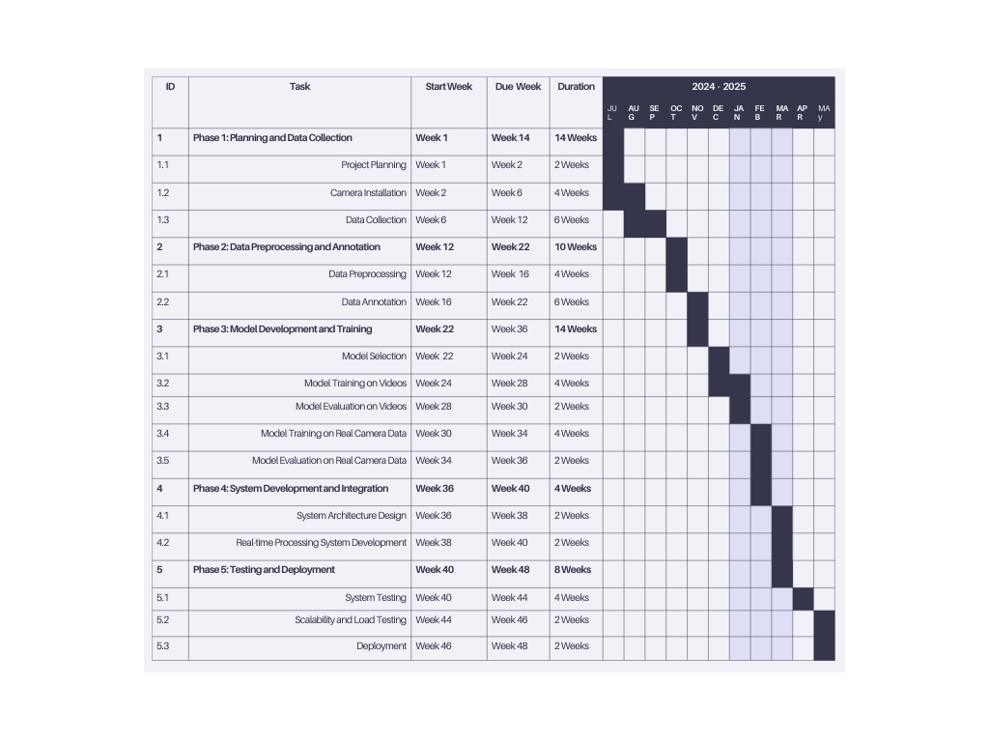
Gantt Chart
IT21212222 | <<Seneviratne.K.A.C.M>> | <<24-25J-165>>

Slide 16
References
Chen, T., Li, S., Zhang, Y., & Chen, Z. (2020). "Real-Time Traffic Violation Detection System Based on Deep Learning." IEEE Transactions on Intelligent Transportation Systems, 21(3), 1106-1114. doi:10.1109/TITS.2019.2919565.
Wang, J., Liu, Z., & Wang, L. (2019). "Vehicle Identification and Tracking Based on Deep Learning." IEEE Access, 7, 14250-14261. doi:10.1109/ACCESS.2019.2893916.
Zhang, H., Wang, X., & Xu, J. (2018). "Real-Time Traffic Signal Control and Vehicle Detection System." In Proceedings of the IEEE International Conference on Intelligent Transportation Systems (ITSC), 3015-3020. doi:10.1109/ITSC.2018.8569342.
IT21212222 | <<Seneviratne.K.A.C.M>> | <<24-25J-165>>

Slide 17

IT21186288 | Wennawaththa.W.W.V.N
BSc (Hons) Degree in Information BSc (Hons) Degree in Information Technology
Specialized in Information Technology
IT21186288 | <<Wennawaththa.W.W.V.N>> | <<Project ID>>

Slide 18
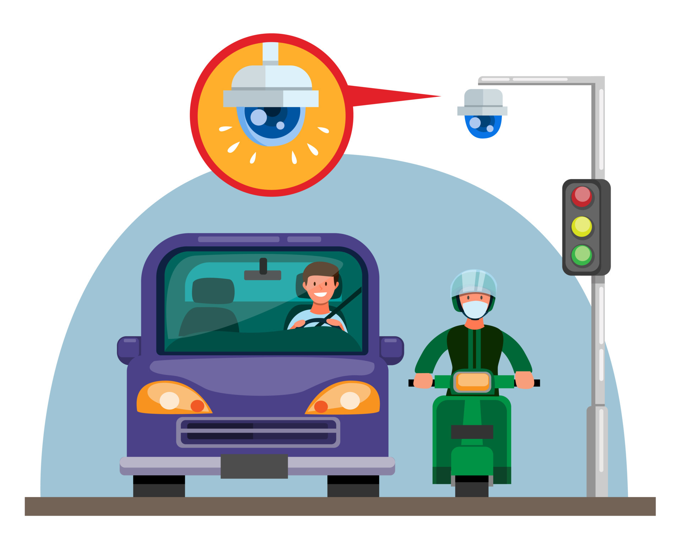
Background
Vehicle detection
Invalid U turn detection
Vehicle classification
License plate recognition (LPR)
IT21186288 | <<Wennawaththa.W.W.V.N>> | <<Project ID>>

Slide 19


Research Problems
Image processing
Real-time Processing
License Plate detection
Occlusions
IT21186288 | <<Wennawaththa.W.W.V.N>> | <<Project ID>>

Slide 20
Research Gap
Aspect | System A | System B | System C | Our Project
Real-time Traffic Data Integration
Automated number plate detection
Real-time image processing

Slide 21
Objective
Accurate and Real-time Vehicle Detection
Precise Vehicle Classification
Robust License Plate Recognition (LPR)
Sub-Objective
detecting vehicles under varying lighting conditions and weather
classification models to distinguish between different vehicle types
Develop accurate LPR algorithms for different license plate formats and fonts.
IT21186288 | <<Wennawaththa.W.W.V.N>> | <<Project ID>>

Slide 22
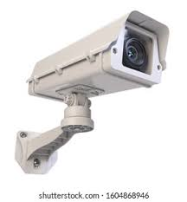


Methodology
Violation Records​
Database
Cameras
Get red light violation data
Central Server
Detection Models​ & vehicle identification system
Edge Processing Unit ​
Red light & stopline violation detection System ​

Slide 23

Technology
Computer Vision: OpenCV
Hardware: High-resolution cameras
Software: Python

Slide 24
Functional Requirements
Vehicle plate number capturing
Vehicle Classification
Character Recognition
Non-Functional Requirements
Security​
Maintainability​
Performance​
Privacy
IT21186288 | <<Wennawaththa.W.W.V.N>> | <<Project ID>>

Slide 25
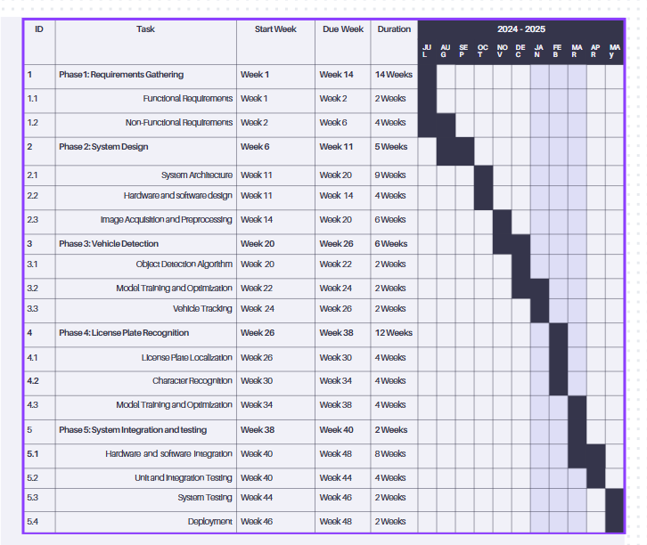
Gantt chart

Slide 26

IT21334306 | Wathsala W.H.D
BSc (Hons) Degree in Information BSc (Hons) Degree in Information Technology
Specialized in Information Technology
IT21334306 | <<Wathsala W.H.D>> | <<Project ID>>

Slide 27
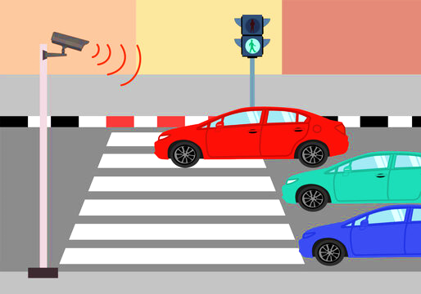
Background
Importance of violation detection near junctions.
Reduce accidents near pedestrian crossing lines.
Real-Time violation Detection.
IT21334306 | <<Wathsala W.H.D>> | <<Project ID>>

Slide 28

Research Problem
Real-time Processing issues.
Capturing images under rainy weather conditions.
Capturing images in low light conditions.
IT21334306 | <<Wathsala W.H.D>> | <<Project ID>>

Slide 29
Research Gap
Aspect | System 1 | System 2 | System 3 | Our System
Capturing under rainy conditions
Vehicle identification
Capturing violations related to pedestrian crossing
IT21334306 | <<Wathsala W.H.D>> | <<Project ID>>

Slide 30
Objective
To develop an advanced traffic monitoring system that accurately identifies pedestrian crossing line violations using a backup camera system enhanced with computer vision and machine learning technologies.
Sub-Objectives
Pedestrian safe
Existing Systems
IT21334306 | <<Wathsala W.H.D>> | <<Project ID>>

Slide 31
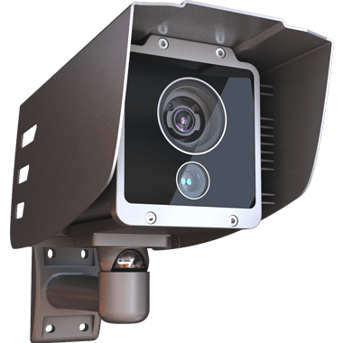







Methodology
Violation Detection Cameras
Database
Capture Violation
Violation Data Records
Main Server
Analize frames for violations
Send violation Footages
Capture Violation
Processing Unit
Detection Models
Crossing line Violation & Backup camera System
IT21334306 | <<Wathsala W.H.D>> | <<24-25J-165>>

Slide 32


Technology
Open CV
Python

Slide 33
Functional Requirements
The system should detect vehicles ignoring pedestrian signals.
Cameras should capture clear images of the violating vehicles & drivers
Non-Functional Requirements
Security
Speed & Performance
Reliability
IT21334306 | <<Wathsala W.H.D>> | <<Project ID>>

Slide 34
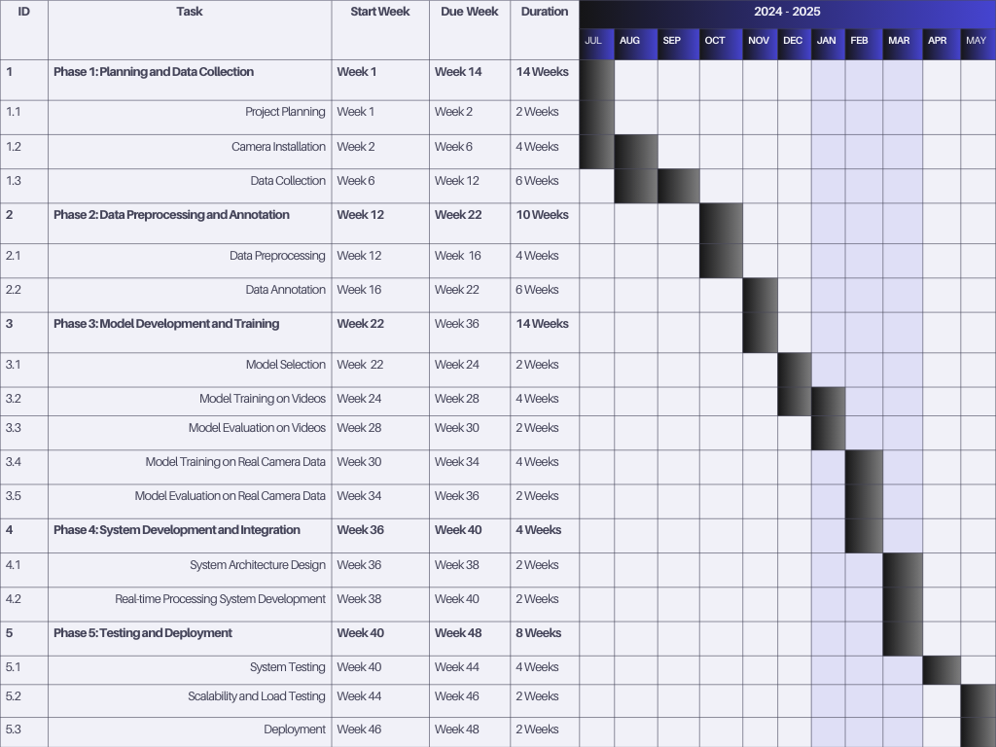
Gantt Chart
IT21334306 | <<Wathsala W.H.D>> | <<Project ID>>

Slide 35
References
https://www.researchgate.net/search.Search.html?query=traffic+detection&type=publication
https://www.researchgate.net/publication/382121395_Traffic_Object_Detection_and_Recognition_Systems
IT21334306 | <<Wathsala W.H.D>> | <<Project ID>>

Slide 36

IT21327926 | Mahindapala.g.h.n.k
BSc (Hons) Degree in Information BSc (Hons) Degree in Information Technology
Specialized in Information Technology
IT2127926 | <<Mahindapala.G.H.N.K>> | <<24-25J-165>>

Slide 37
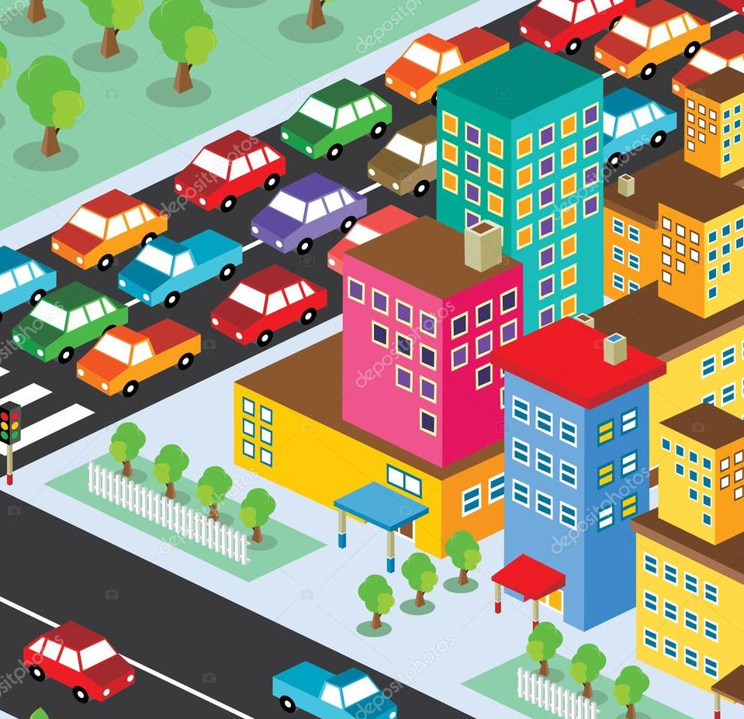
Background
Urban Traffic Growth
Need for Real-time Updates
High Violation Rates
Tech Solutions
IT2127926 | <<Mahindapala.G.H.N.K>> | <<24-25J-165>>

Slide 38

Research Problem
Ensuring Data Accuracy
System Integration Challenges
Privacy and Security Issues
IT2127926 | <<Mahindapala.G.H.N.K>> | <<24-25J-165>>

Slide 39
Research Gap
Aspect | System A | System B | System C | Our Project
Real-time Traffic Data Integration
Automated Vehicle Profiling
Comprehensive Violation Reporting
IT2127926 | <<Mahindapala.G.H.N.K>> | <<24-25J-165>>

Slide 40

Specific Objective and Sub Objectives
Objective
Develop an integrated system that analyzes real-time traffic data, displays traffic status via LED screens, and automatically reports traffic violations to nearby police stations.
Sub Objectives
Implement real-time traffic analysis.
Set up LED displays for traffic updates.
Maintain vehicle profiles for violations.
Automate violation reporting to police.
IT2127926 | <<Mahindapala.G.H.N.K>> | <<24-25J-165>>

Slide 41
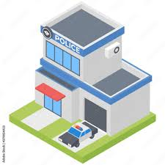

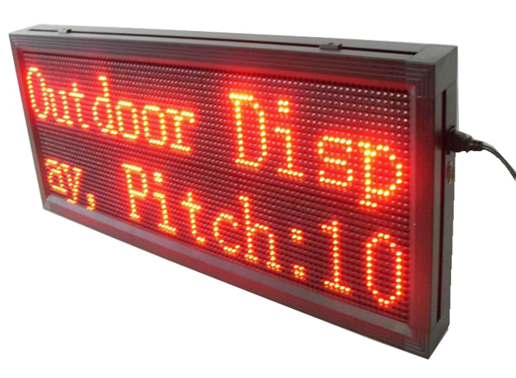
Methodology
Data Base
Cameras
Detected violation data
Refer the updates
Capture Traffic
Reporting Detected Violations
Analyse traffic
Send Data
Central Server
Analyse & Maintaining Profiles
Edge Processing Unit
Web Application
Display Traffic status
LED Desplay
IT2127926 | <<Mahindapala.G.H.N.K>> | <<24-25J-165>>

Slide 42



Technology
Open CV
Python
MongoDB
MERN Stack

Slide 43


Functional Requirments
Real-time Data Collection
LED Traffic Status Display
Vehicle Profile Management
Automated Violation Reporting
Non - Functional Requirments
Reliability
Data Security
Scalability
Usability
IT2127926 | <<Mahindapala.G.H.N.K>> | <<24-25J-165>>

Slide 44
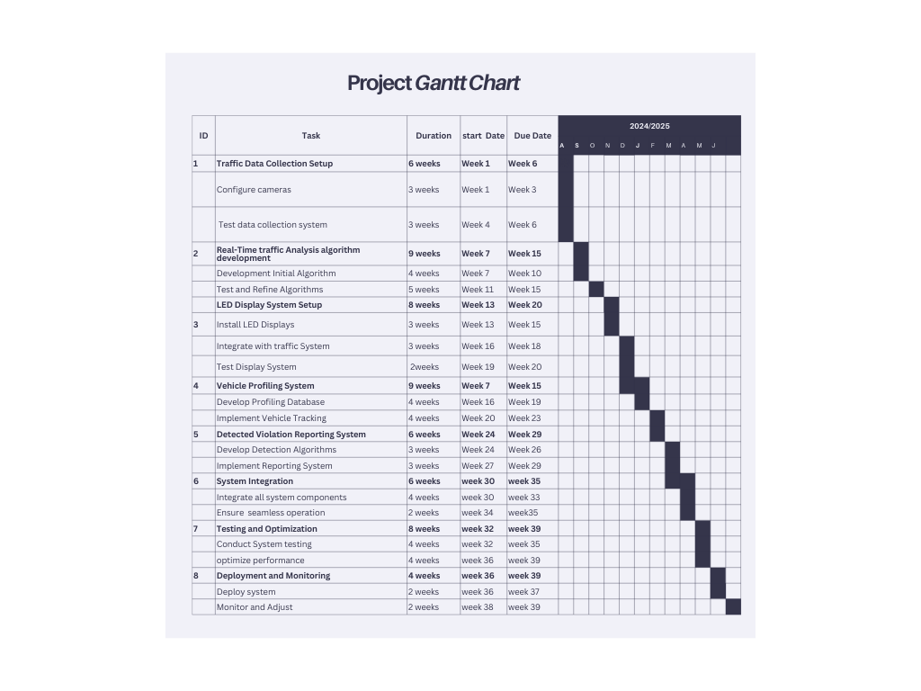
Gantt Chart
IT2127926 | <<Mahindapala.G.H.N.K>> | <<24-25J-165>>

Slide 45
References
Zhang, H., & Liu, H. X. (2013). A review of traffic congestion detection, mitigation, and control. Transportation Research Part B: Methodological, 52, 1-24.
Hartenstein, H., & Laberteaux, K. P. (2008). VANET: Vehicular Applications and Inter-Networking Technologies. John Wiley & Sons.
Sun, Z., Bebis, G., & Miller, R. (2006). On-road vehicle detection: A review. IEEE Transactions on Pattern Analysis and Machine Intelligence, 28(5), 694-711.
Liu, Y., Zhang, Y., & Gao, Y. (2019). A cloud-based IoT framework for intelligent traffic management and violation detection. IEEE Transactions on Intelligent Transportation Systems, 20(1), 308-319.

Slide 46
Thank you

Slide 47


